Slide 1

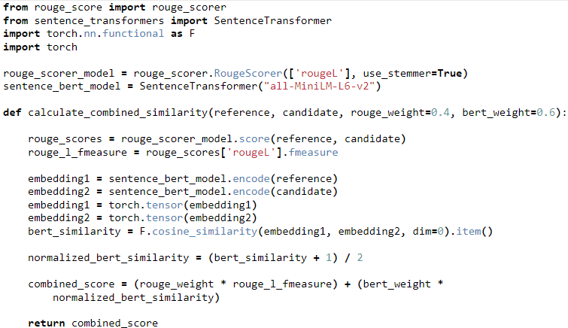
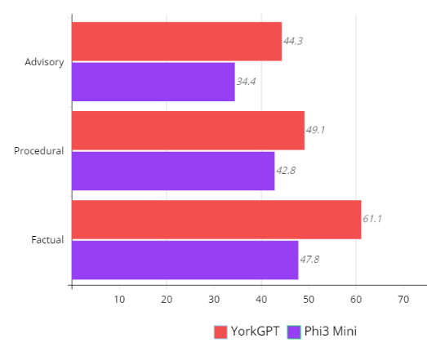
Data Integrity in Large Language Model (LLM) Retrieval Augmented Generation (RAG)
Darryl Nurse, Department of Math and Computer Science
Mentor: Dr. Abu Kamruzzaman, Department of Business and Economics
ABSTRACT
METHODOLOGY
DISCUSSION
This project aims to quantify the impact of data integrity and quality in Finetuning of Large Language Models and Retrieval Augmented Generation in Business Grade Applications.
To accurately assess the role of data integrity in LLM and RAG capabilities, an application titled YorkGPT was created to provide a pipeline from data collection to the user. It was divided between two main subsystems: Model Finetuning, where training data is collected and applied to model weights, and Model Inference, in which the model generated a response based on the user's query and context derived from Retrieval Augmented Generation. These two subsystems belonged to the Server-side architecture and were encapsulated with Docker containerization to run on a GPU accelerated machine for enhanced training and inference speed.
After witnessing and analyzing the ability of the YorkGPT system to generate accurate and relevant responses for users, the role of data integrity becomes clear in ensuring LLM System functionality. Collection, cleaning and transformation of data from current, verified sources - the York College Website - allows it to be divided into both static and dynamic categories. Then, applying it to Fine Tuning and RAG operations respectively, data can determine inherent generation behavior while also empowering the LLM with a constant stream of updated information. This source of reliable data, available through the Websites API, ensures not only data integrity, but also data transparency for what is used in model creation. Additionally, due to the minimal human input of this procedure, opportunities open for continuous, autonomous finetuning, of the model – something which is within the sights of this project. However, there exist limitations in data collection. The ETL pipeline was achieved through API data collection, transformation scripts and natural language processing. As such, the data provided to the model, while genuine, was limited to the textual information provided by the Website, which, from certain endpoints, could be minimal. Therefore, in certain contexts where students may inquire information, the model has reduced inference performance due to its lack of training on the topic. Likewise, if data was not present in vector stores, RAG capabilities were reduced. This limitation could be mitigated with more valid sources of data outside of the API, supplemented with more complex data collection scripts to process this data. However, this can increase overhead, requiring more resources for data collection, and thus, increasing model fine-tuning and context retrieval time. Thus, with more planning and resources, these issues can be resolved.
OBJECTIVES
Ultimately, this project aims to produce insights into the creation and use of Large Language Models developed with enterprise data, and the significance of data collection and transformation techniques to assure model quality and efficiency.
Model Finetuning: Text data to update the model weights was continuously collected from the API of the York College website. This data was processed utilizing Extract, Transform and Load (ETL) principles, creating a dataset in the ShareGPT format for finetuning, which was achieved using an Unsloth finetuning script, and Microsoft’s Phi-3 Mini as base model.
Model Inference: Ollama allowed this subsystem to load the model into memory, where it could be utilized by Langchain modules to incorporate retrieval of structured text data stored in a Postgres Vector Database. A Flask Server API called the modules to act as an intermediary between the Client and the Model.
INTRODUCTION
Large Language Model(LLM)s lend themselves to be among the most prominent applications of Generative Artificial Intelligence (Gen AI). These models are trained on vast amounts of textual data from various sources and can provide relational and semantic context between commonly occurring words, sentences and language structures. The textual data originates from existing websites, documents, books and articles, and serves as the scope of knowledge at which the LLM can operate. However, in an age of dynamic information, this has its limitations. To incorporate new data models must be retrained, consuming large amounts of resources. With Retrieval Augmented Generation (RAG), LLMs can draw data from sources they were not exposed to during training, enhancing their text generation capabilities and increasing the extent of their knowledge. Although, like Finetuning, RAG has its own limitations – in applications where dynamic information is used to supplement model inference, data stored for retrieval must constantly be updated and verified. In business grade systems, LLMs are used for interactions where users require more information than what is quickly or readily available. In this use case, managing the source and application of data becomes integral, as it enhances LLM capabilities and ensures increased functionality to users.
Utilizing this system to generate responses from the YorkGPT model with RAG, analysis of the factuality, relevance and quality of the generated response provides insight into the role data integrity plays in LLM development and deployment.
A small dataset of verified question-answer pairs was generated from endpoints of the API used to train the model. The questions from this dataset, divided into three categories, were presented to the model, and once responses were collected alongside those of the base model, Phi3-Mini, similarity analysis of the generated text and verified data was performed using combined methodologies of Sentence-BERT Embeddings and Recall-Oriented Understudy for Gisting Evaluation (ROUGE).
RESULTS
Figure 1: Code Snippet of the Sentence Similarity
Analysis Function
Figure 2: Chart Depicting the Average Similarity Index Percentage of Categorical Model Responses
REFERENCES
Zhou, Chunting, et al. "Lima: Less is more for alignment." Advances in Neural Information Processing Systems 36 (2024).
The model’s higher performance against factual, procedural and advisory queries highlights the role data integrity plays in ensuring LLM functionality.
ACKNOWLEDGEMENTS
Thank you Dr. Kamruzzaman, you are a wonderful mentor and motivator. Also, thank you to the York College IT team for their support, knowledge and wisdom.

